Slide 1
2.5 Introduction to Computers U2C5

Slide 2
2.5 Introduction to Computers
Overview:
The goal of this lesson is to explore the history and parts of the computer. The lesson utilizes resources from Intel's "The Journey Inside: The Computer" series.
Objectives: Students will be able to:
1. List examples of early calculating machines
2. Describe the four problems of tube-based computer
3. Describe the function of a transistor
4. Describe the four parts of a computer
5. Categorize a given computer part
6. Distinguish between storage drives and memory chips
7. Distinguish between RAM, ROM and Flash memory chips

Slide 3
Worksheet
Introduction to Computers
Name:_________________________ Period:___ Date:________ Score:_____/18
1. (2 pts) Name two non-electronic calculating devices:
2. (3 pts) What type of switch did the first electronic (like ENIAC) computers use? What were four problems with this type of computers:
3. (2 pts) What type of switch do modern electronic computers use? What are they most commonly made of?
4. (2 pts) When circuits containing several of these modern switches are integrated onto one component, what are these called? Give both the technical name and the common name.
5. (4 pts) What are four parts of a computer. Give an example of each.
6. (2 pts) What is the difference between a storage drive and a memory chip. Give an example of each.
7. (3 pts) What are the 3 most common types of memory chips. What is typically stored in each?
Notes:
Answer Key:
Introduction to Computers [1]
Submitted by Randy Steele [2] on 11 July, 2011 - 16:17
Answer Key: Introduction to Computers Worksheet
The abacus, Stonehenge and the slide rule are all examples of non-electronic calculating devices
Early computers used vacuum tubes as switches. These switches made early computers big, hot flakey and expensive
Modern computers use switches called transistors. Most transistors are made of silicon.
When many transistors are integrated onto a silicon piece of silicon, this is called an integrated circuit (technical name) or computer chip (common name)
Input – mouse, keyboard, microphone, scanner Output – screen, speakers, printer Processor – microprocessor Storage – hard drive, CD/DVD drive, RAM, ROM, Flash
Storage drives have a rotating storage disk – hard drive (magnet disk), DVD drive (optical disk) Memory chips are rectangles of silicon that have no moving parts – RAM, ROM or Flash
RAM – software ROM – firmware Flash – software or firmware
_____________________________________________________________
Source URL: http://stemrobotics.cs.pdx.edu/node/343

Slide 4
2.5 Introduction to Computers
(8:20)
Intel "The Journey Inside:
The Computer - Introduction to Computers" video
http://stemrobotics.cs.pdx.edu/node/476
http://stemrobotics.cs.pdx.edu/sites/default/files/INTEL_JOURNEY_INSIDE-chapter1.flv
Notes:
Instruction Guide:
Introduction to Computers [1]
Submitted by Randy Steele [2] on 11 July, 2011 - 14:06
This lesson delves into the technology behind the history and parts of computers.
Review the Introduction to Computers worksheet with students before watching the Intel video.
Have student take notes during video
After watching the Intel "Introduction to Computers", supplement discussion with History and Parts of a Computer PPT (use slideshow mode for proper animation)
History of Computers (video/PPT)
Ancient calculating devices included the abacus and Stonehenge
Use the more recent example of a slide rule (optional: show students a slide rule)
Vacuum tubes were used as switches in early computers circuits
Show sample vacuum tube and/or PPT slide 1
Vacuum tubes are electronic switches made of conductors and insulators
Need to operate in a vacuum – like a light bulb
Ask students to speculate on the 4 problems that limited the success of vacuum-tube based computers:
Big – filled several rooms
Hot – each tube generated as much heat as eight 60W light bulbs. Computers had thousands of tubes and used as much electricity as a small town.
Flakey – they broke down frequently. Wires would come loose, or any of the tubes could burn out like a light bulb
Expensive – both to build (tubes, other parts, building, air conditioning, etc.) and to operate (required a large staff, electricity cost, replacement parts, etc.). Only the government or large companies could afford these systems.
Tube based computers had thousands of tubes and were about as powerful as a basic calculator
Show students a “$1.99” calculator and/ or PPT slide 2
It is not big, it does not get hot, it is not flakey, it is not expensive
Ask students what changed?
The switch changed from a vacuum tube to a transistor
Show transistor sample and/ or PPT slide 3
A transistor is a semiconductor switch
Used in modern computer circuits
Most commonly made of silicon
When multiple transistors are made on one piece of silicon is it called an “integrated circuit” or, more commonly, a “computer chip”
A microprocessor is a complex computer chip
Transistors on modern microprocessors are extremely small
In 2010, a circuit with over one billion (1,000,000,000) transistors would fit on a dime
We’ll explore this phenomena in the Moore’s Law section of this lesson
The Four Parts of a Computer (video/PPT)
After watching the video supplement discussion with History and Parts of a Computer PPT (use slideshow mode for proper animation)
Ask students name the four parts of a computer and give an example of each part
Input – keyboard, mouse, microphone, touch-screen, scanner, camera, etc.
Output – screen, speakers, printer, etc.
Ask students about a modem (it is both input and output)
No need to dwell on inputs and outputs, since student are most familiar with these
Processor – two types:
Embedded processors – can only be programmed by their manufacturer (TV remote, watches, cameras, etc.)
Microprocessor – can run programs from many sources (some brand names: Intel, AMD, Pentium, Core, i5, etc.)
We’ll explore processors in more depth in Hardware/Software/Firmware: Microprocessors lesson
Storage – two types (PPT slide 3)
Mechanical drives: (Show drive samples and/ or PPT slide 4)
Motor spins storage surface
Hard drive – “hard” magnetic disc
Floppy drives – “floppy” magnetic disc
CD/DVD drive – laser readable/writeable disc
Memory chips - RAM, ROM, Flash (Show drive samples and/ or PPT slide 5)
Silicon chips (semiconductors with many transistors) - no moving parts
Chip are manufactured on discs of silicon, called wafers
Each rectangle on the wafer is an individual chip
Wafer are cut into rectangles, and each chip is put in a package
Wires connect to the chip and then protrude from the package
Packaged chip are installed on circuit boards which connect the wires protruding from the chip to other parts of the larger circuit
RAM – Random Access Memory
Used to store/run software programs
Loses content when turned off
ROM – Read Only Memory
Used to store/run firmware programs
Retains contents when turned off
Firmware written by manufacturer
Defines “vocabulary” of chip
Tells chip what to do when first turned on
Cannot be changed by user
Flash
Used for both software and firmware
Retains contents when turned off
The Flash “drive” name is misleading – there are no moving parts
Flash “drives” effectively replaced the floppy drive’s function, so the drive name stuck

Slide 5
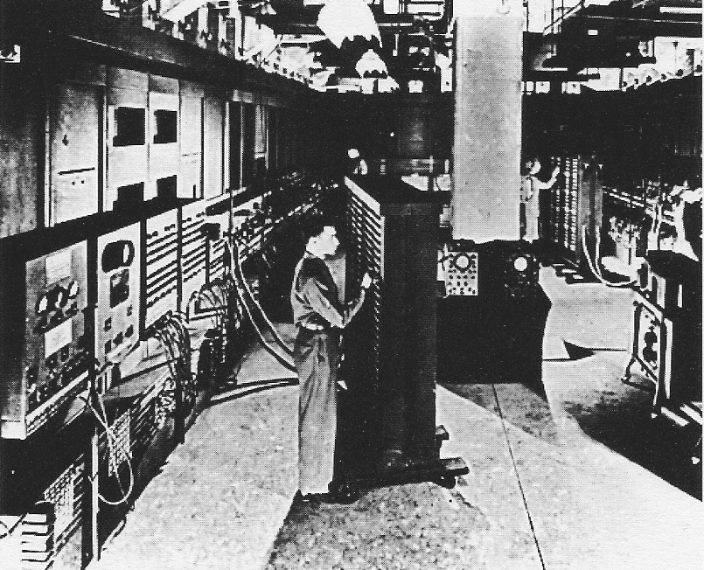
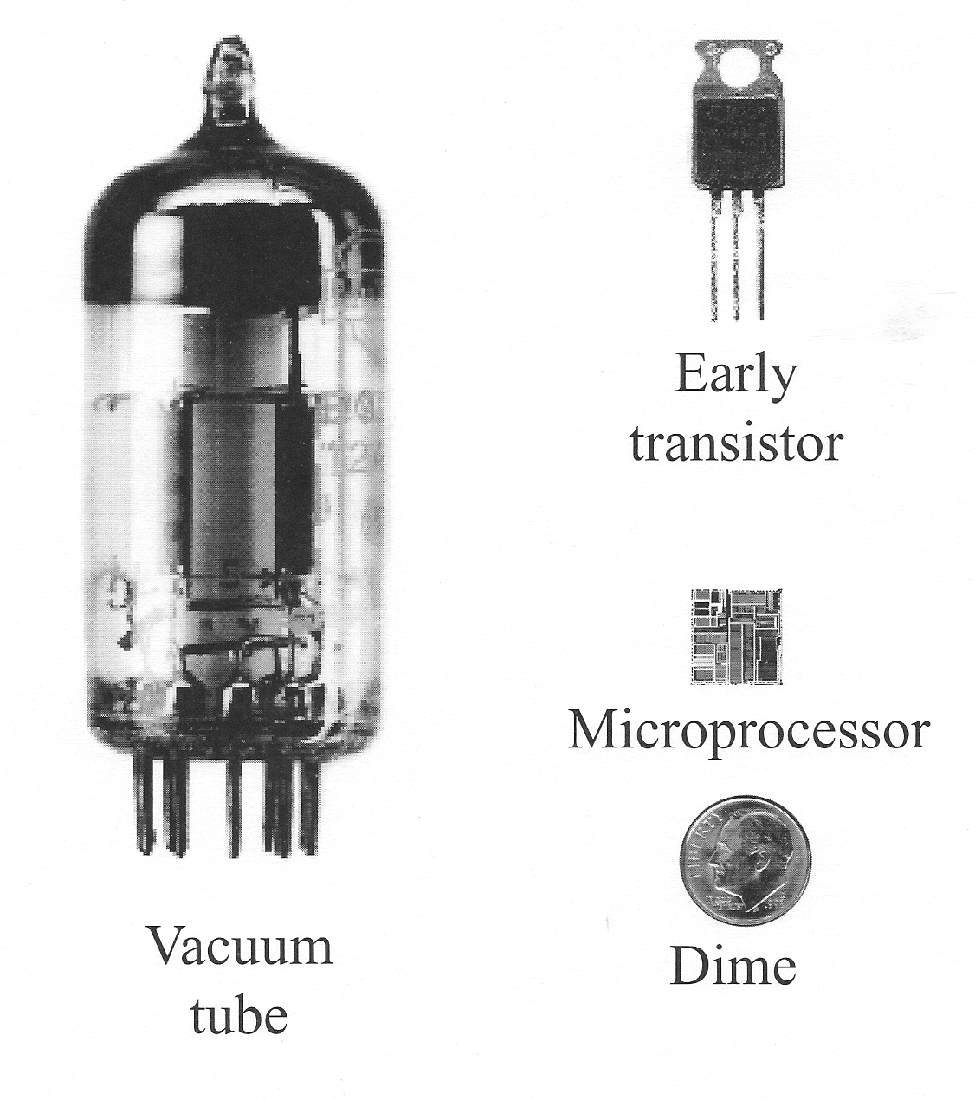
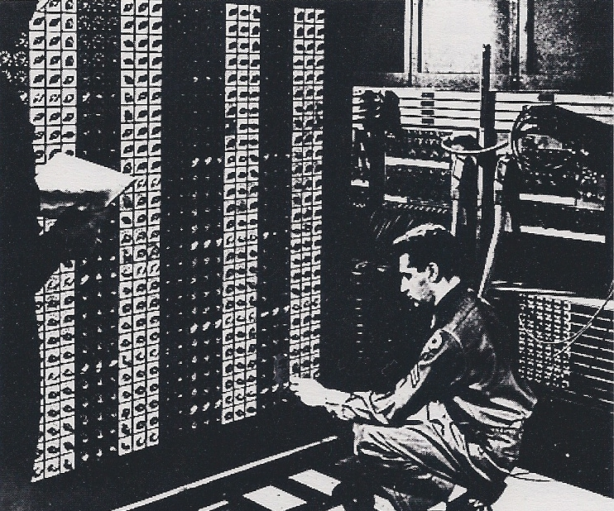
Vacuum Tube
Computers
Vacuum Tube Switches
Conductors
Insulators
Needs vacuum
Vacuum Tube
Computer Problems
BIG
Hot (electricity hog)
Flakey
Expen$$$$ive
About as powerful as a basic calculator
Notes:
After watching the Intel "Introduction to Computers", supplement discussion with History and Parts of a Computer PPT (use slideshow mode for proper animation)
History of Computers (video/PPT)
Ancient calculating devices included the abacus and Stonehenge. Use the more recent example of a slide rule (optional: show students a slide rule)
Vacuum tubes were used as switches in early computers circuits
Show sample vacuum tube and/or PPT slide 1
Vacuum tubes are electronic switches made of conductors and insulators
Need to operate in a vacuum – like a light bulb
Ask students to speculate on the 4 problems that limited the success of vacuum-tube based computers:
Big – filled several rooms
Hot – each tube generated as much heat as 8 60W lt bulbs. Computers had thousands of tubes and used as much electricity as a small town.
Flakey – they broke down frequently. Wires would come loose, or any of the tubes could burn out like a light bulb
Expensive –to build (tubes, other parts, building, air cond, etc.) and to operate (required a large staff, electricity cost, replacement parts, etc.). Only the government or large companies could afford.
Tube based computers had thousands of tubes and were about as powerful as a basic calculator

Slide 6
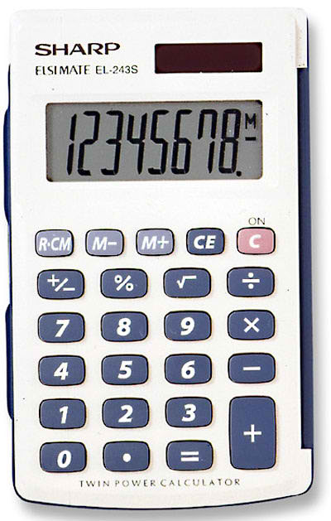
But, today……
A Basic Calculator:
Is not BIG
Small enough to fit in a pocket
Is not Hot (not an electricity hog)
Even runs from a tiny solar cell
It is not Flakey
Never breaks down
Is not Expen$$$$ive
Costs about $1.99
What happened???
Notes:
Show students a “$1.99” calculator and/ or PPT slide 2
It is not big, it does not get hot, it is not flakey, it is not expensive
Ask students what changed?
The switch changed from a vacuum tube to a transistor

Slide 7
A New Switch: The Transistor
The switches changed from:
Vacuum tubes to transistors
A semiconductor switch
Commonly made of silicon
Many transistors can be
integrated onto one “chip” of silicon:
Integrated Circuit
or “Computer Chip”
A microprocessor is a complex computer chip
The transistors on a modern computer chip are microscopic
Notes:
Show transistor sample and/ or PPT slide 3
A transistor is a semiconductor switch
Used in modern computer circuits
Most commonly made of silicon
When multiple transistors are made on one piece of silicon is it called an “integrated circuit” or, more commonly, a “computer chip”
A microprocessor is a complex computer chip
Transistors on modern microprocessors are extremely small
In 2010, a circuit with over one billion (1,000,000,000) transistors would fit on a dime
We’ll explore this phenomena in the Moore’s Law section of this lesson

Slide 8
Review Question 1
What kind of switches did the first electronic computers (like Eniac) use?
A) Transistors
B) Wires
C) Insulators
D) Vacuum Tubes
E) None of the above
Notes:
What kind of switches did the first electronic computers (like Eniac) use?
A) Transistors
B) Wires
C) Insulators
D) Vacuum Tubes
E) None of the above

Slide 9
Review Question 1
What kind of switches did the first electronic computers (like Eniac) use?
A) Transistors
B) Wires
C) Insulators
D) Vacuum Tubes
E) None of the above
Notes:
What kind of switches did the first electronic computers (like Eniac) use?
A) Transistors
B) Wires
C) Insulators
D) Vacuum Tubes
E) None of the above

Slide 10
Review Question 2
The 4 problems with Vacuum Tube computers were that they were Big, Hot ……
A) Ugly & Old
B) Noisy & Flakey
C) Flakey & Expensive
D) Expensive & Old
E) None of the above
Notes:
The 4 problems with Vacuum Tube computers were that they were Big, Hot ……
A) Ugly & Old
B) Noisy & Flakey
C) Flakey & Expensive
D) Expensive & Old
E) None of the above

Slide 11
Review Question 2
The 4 problems with Vacuum Tube computers were that they were Big, Hot ……
A) Ugly & Old
B) Noisy & Flakey
C) Flakey & Expensive
D) Expensive & Old
E) None of the above
Notes:
The 4 problems with Vacuum Tube computers were that they were Big, Hot ……
A) Ugly & Old
B) Noisy & Flakey
C) Flakey & Expensive
D) Expensive & Old
E) None of the above

Slide 12
Review Question 3
Modern electronics do not have these problems because they use a switch called a
A) Computer Chip
B) Transistor
C) Microprocessor
D) Conducting Path
E) None of the above
Notes:
Modern electronics do not have these problems because they use a switch called a
A) Computer Chip
B) Transistor
C) Microprocessor
D) Conducting Path
E) None of the above

Slide 13
Review Question 3
Modern electronics do not have these problems because they use a switch called a
A) Computer Chip
B) Transistor
C) Microprocessor
D) Conducting Path
E) None of the above
Notes:
Modern electronics do not have these problems because they use a switch called a
A) Computer Chip
B) Transistor
C) Microprocessor
D) Conducting Path
E) None of the above

Slide 14
Review Question 4
Transistors are one type of
A) Insulator
B) Conductor
C) Computer Chip
D) Semiconductor
E) None of the above
Notes:
Transistors are one type of
A) Insulator
B) Conductor
C) Computer Chip
D) Semiconductor
E) None of the above

Slide 15
Review Question 4
Transistors are one type of
A) Insulator
B) Conductor
C) Computer Chip
D) Semiconductor
E) None of the above
Notes:
Transistors are one type of
A) Insulator
B) Conductor
C) Computer Chip
D) Semiconductor
E) None of the above

Slide 16
The Four Parts of a Computer
Input
Keyboard
Mouse
Microphone
Touch Screen
Scanner
Camera
Output
Screen
Speakers
Printer
Processor
Embedded Processors
Microprocessor
Storage
Mechanical Drives
Memory Chips
Notes:
The Four Parts of a Computer (video/PPT)
After watching the video supplement discussion with History and Parts of a Computer PPT (use slideshow mode for proper animation)
Ask students name the four parts of a computer and give an example of each part
Input – keyboard, mouse, microphone, touch-screen, scanner, camera, etc.
Output – screen, speakers, printer, etc.
Ask students about a modem (it is both input and output)
No need to dwell on inputs and outputs, since student are most familiar with these
Processor – two types:
Embedded processors – can only be programmed by their manufacturer (TV remote, watches, cameras, etc.)
Microprocessor – can run programs from many sources (some brand names: Intel, AMD, Pentium, Core, i5, etc.)
We’ll explore processors in more depth in Hardware/Software/Firmware: Microprocessors lesson
Storage – two types (PPT slide 3&4)

Slide 17
Storage Devices
Mechanical Drives
Memory Chips
Rotating storage surface
Very large capacity
Hard Drives
CD or DVD Drives
Floppy Drives
No moving parts
Medium to large capacity
RAM
ROM
Flash
Notes:
Storage – two types (PPT slide 3)
Mechanical drives: (Show drive samples and/ or PPT slide 4)
Motor spins storage surface
Hard drive – “hard” magnetic disc
Floppy drives – “floppy” magnetic disc
CD/DVD drive – laser readable/writeable disc
Memory chips - RAM, ROM, Flash (Show drive samples and/ or PPT slide 5)
Silicon chips (semiconductors with many transistors) - no moving parts
Chip are manufactured on discs of silicon, called wafers
Each rectangle on the wafer is an individual chip
Wafer are cut into rectangles, and each chip is put in a package
Wires connect to the chip and then protrude from the package
Packaged chip are installed on circuit boards which connect the wires protruding from the chip to other parts of the larger circuit
RAM – Random Access Memory
Used to store/run software programs
Loses content when turned off
ROM – Read Only Memory
Used to store/run firmware programs
Retains contents when turned off
Firmware written by manufacturer
Defines “vocabulary” of chip
Tells chip what to do when first turned on
Cannot be changed by user
Flash
Used for both software and firmware
Retains contents when turned off
The Flash “drive” name is misleading – there are no moving parts
Flash “drives” effectively replaced the floppy drive’s function, so the drive name stuck.

Slide 18
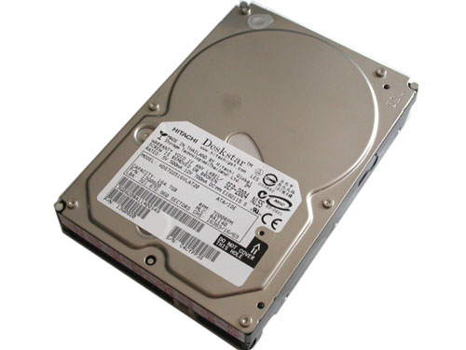
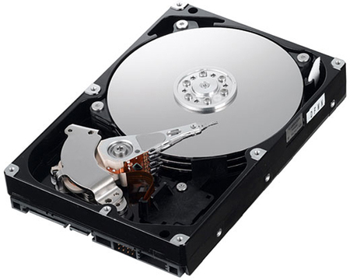
Mechanical Drives
Hard Drive
Rotating magnetic disc is “hard”
Highest storage capacity
Fastest mechanical drive
Sealed, no physical access
Floppy Drive
Rotating magnetic disc is “floppy”
Low storage capacity and slow
Portable and reusable diskettes
CD/DVD Drive
Rotating disc is laser readable
Medium storage capacity
Relatively slow
Portable and cheap discs
Notes:
Storage – two types (PPT slide 3)
Mechanical drives: (Show drive samples and/ or PPT slide 4)
Motor spins storage surface
Hard drive – “hard” magnetic disc
Floppy drives – “floppy” magnetic disc
CD/DVD drive – laser readable/writeable disc

Slide 19
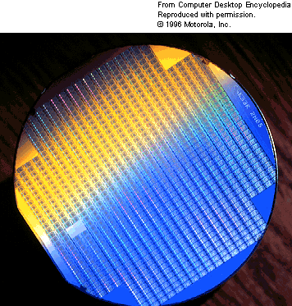
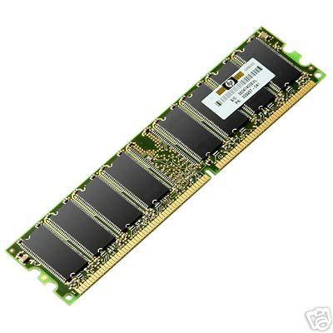
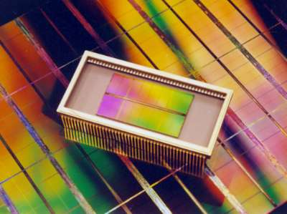
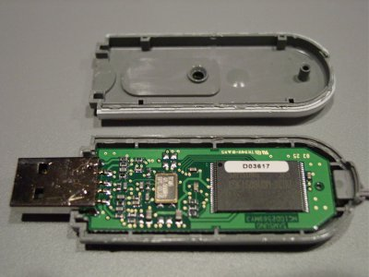
Memory Chips
RAM (Random Access Memory)
Fastest memory chips
Relatively small capacity
Used to run Software
Loses contents when turned off
RAM
Wafer
RAM
Circuit
Board
ROM (Read Only Memory)
Fast, low capacity
Used for Firmware (Manufacturer only)
Retains contents when turned off
Packaged RAM Chip
Flash “Drive”
Flash
High capacity, relatively slow
Used for Software & Firmware
Retains contents when turned off
Flash “drive” name misleading
no moving parts
Notes:
Memory chips - RAM, ROM, Flash (Show drive samples and/ or PPT slide 5)
Silicon chips (semiconductors with many transistors) - no moving parts
Chip are manufactured on discs of silicon, called wafers
Each rectangle on the wafer is an individual chip
Wafer are cut into rectangles, and each chip is put in a package
Wires connect to the chip and then protrude from the package
Packaged chip are installed on circuit boards which connect the wires protruding from the chip to other parts of the larger circuit
RAM – Random Access Memory
Used to store/run software programs
Loses content when turned off
ROM – Read Only Memory
Used to store/run firmware programs
Retains contents when turned off
Firmware written by manufacturer
Defines “vocabulary” of chip
Tells chip what to do when first turned on
Cannot be changed by user
Flash
Used for both software and firmware
Retains contents when turned off
The Flash “drive” name is misleading – there are no moving parts
Flash “drives” effectively replaced the floppy drive’s function, so the drive name stuck

Slide 20
Review Question 5
Which of the following is NOT an example of a Mechanical Drive
A) Floppy Drive
B) Hard Drive
C) Flash Drive
D) DVD Drive
E) None of the above
Notes:
Which of the following is NOT an example of a Mechanical Drive
A) Floppy Drive
B) Hard Drive
C) Flash Drive
D) DVD Drive
E) None of the above

Slide 21
Review Question 5
Which of the following is NOT an example of a Mechanical Drive
A) Floppy Drive
B) Hard Drive
C) Flash Drive
D) DVD Drive
E) None of the above
Notes:
Which of the following is NOT an example of a Mechanical Drive
A) Floppy Drive
B) Hard Drive
C) Flash Drive
D) DVD Drive
E) None of the above

Slide 22
Review Question 6
Which of the following is NOT an example of a Memory Chip
A) RAM
B) ROM
C) Flash drive
D) Memory card
E) None of the above
Notes:
Which of the following is NOT an example of a Memory Chip
A) RAM
B) ROM
C) Flash drive
D) Memory card
E) None of the above

Slide 23
Review Question 7
A Hard Drive is called “Hard” because
A) Its hard to find
B) Its hard to open
C) Its outer case is hard
D) Its magnetic surface is hard
E) None of the above
Notes:
A Hard Drive is called “Hard” because
A) Its hard to find
B) Its hard to open
C) Its outer case is hard
D) Its magnetic surface is hard
E) None of the above

Slide 24
Review Question 7
A Hard Drive is called “Hard” because
A) Its hard to find
B) Its hard to open
C) Its outer case is hard
D) Its magnetic surface is hard
E) None of the above
Notes:
A Hard Drive is called “Hard” because
A) Its hard to find
B) Its hard to open
C) Its outer case is hard
D) Its magnetic surface is hard
E) None of the above

Slide 25
Review Question 8
RAM chips are important in computer because they
A) have a large capacity
B) retain information when powered off
C) are very fast
D) have a rotating disc
E) None of the above
Notes:
RAM chips are important in computer because they
A) have a large capacity
B) retain information when powered off
C) are very fast
D) have a rotating disc
E) None of the above

Slide 26
2.5 Introduction to Computers
(3:20)
Recycling the Parts of a Computers Web Video
http://www.livestream.com/thebby/video?clipId=flv_4647d133-b208-4ba9-97dd-f4b25877f284
Notes:
Instructional Material:
Recycling the Parts of a Computers_Web Video [1]
Submitted by Randy Steele [2] on 4 October, 2011 - 08:49
The link below is a video which describes Best Buy's Computer Recycling program - the largest in the country. It describes how the various parts of a computer must be recycled in different ways. Thanks to Matt Bell (Black Hills High School, Tumwater, WA) for finding this link.
http://www.livestream.com/thebby/video?clipId=flv_4647d133-b208-4ba9-97dd-f4b25877f284 [5]
Material Type: Lecture/Presentation
Education Level: Middle School [6]High School [7]
Focus Subject: Science [8]Technology [9]

Slide 28
http://whoknew.news.yahoo.com/?nc&vid=26149281

Slide 29
Introduction to Computers Review
Jeopardy
Notes:
This is the Unit review. Only the Circuits, The NXT and Computer History columns are covered in lessons 2.1, 2.2 & 2.5.
“I only have my class “question” the Circuit, The NXT and Computer History column answers. They all want to try the rest but I tell them those columns will be used when we get to the lessons that cover that material. An effective Hook ☺ “ Roger Hull

Slide 30
Worksheet
Introduction to Computers
Name:__________________ Period:___ Date:________ Score:____/18
1. (2 pts) Name two non-electronic calculating devices:
2. (3 pts) What type of switch did the first electronic (like ENIAC) computers use? What were four problems with this type of computers:
3. (2 pts) What type of switch do modern electronic computers use? What are they most commonly made of?
4. (2 pts) When circuits containing several of these modern switches are integrated onto one component, what are these called? Give both the technical name and the common name.
5. (4 pts) What are four parts of a computer. Give an example of each.
6. (2 pts) What is the difference between a storage drive and a memory chip. Give an example of each.
7. (3 pts) What are the 3 most common types of memory chips. What is typically stored in each?
Notes:
Answer Key:
Introduction to Computers [1]
Submitted by Randy Steele [2] on 11 July, 2011 - 16:17
Answer Key: Introduction to Computers Worksheet
The abacus, Stonehenge and the slide rule are all examples of non-electronic calculating devices
Early computers used vacuum tubes as switches. These switches made early computers big, hot flakey and expensive
Modern computers use switches called transistors. Most transistors are made of silicon.
When many transistors are integrated onto a silicon piece of silicon, this is called an integrated circuit (technical name) or computer chip (common name)
Input – mouse, keyboard, microphone, scanner Output – screen, speakers, printer Processor – microprocessor Storage – hard drive, CD/DVD drive, RAM, ROM, Flash
Storage drives have a rotating storage disk – hard drive (magnet disk), DVD drive (optical disk) Memory chips are rectangles of silicon that have no moving parts – RAM, ROM or Flash
RAM – software ROM – firmware Flash – software or firmware
_____________________________________________________________
Source URL: http://stemrobotics.cs.pdx.edu/node/343

